Slide 1
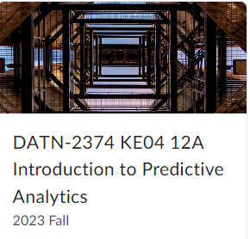

Project
Instructor: Dr. Roger Long
Student name: Poly Bui
Day create: 11/27/2023

Slide 2
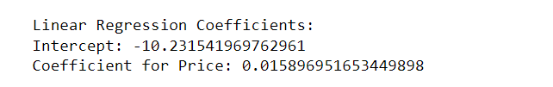
Predict what will happen if TabletCo raises or lowers its price.
After calculator :
We have result for intercept and coefficient like above, so which changing price, the profit will go the same way.
In summary, based on the linear regression model, raising the price is expected to lead to an increase in the predicted value, while lowering the price is expected to lead to a decrease in the predicted value. The magnitude of the effect is determined by the coefficient for the "Price" variable.

Slide 3
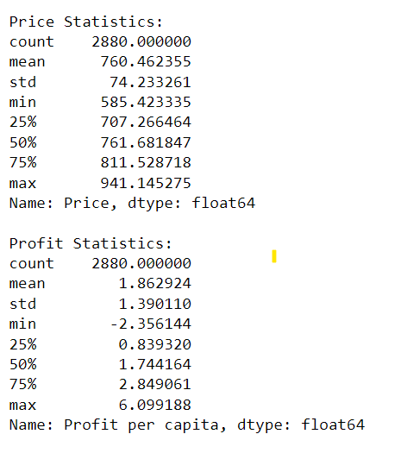
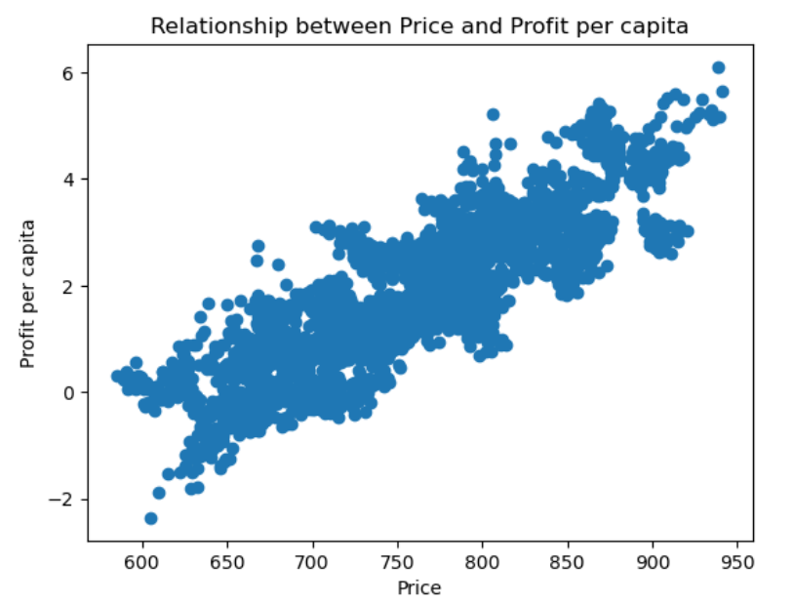
2. Detail the data-generating process you assumed to arrive at your results. Explain how you chose features of the determining function, e.g. its functional form and the variables in it.

Slide 4

1. Data Collection: The process starts with collecting relevant data. it seems to involve price and profit data.
2. Feature Selection: The features (independent variables) chosen for the analysis depend on the context of the problem. "Price" seems to be one of the features. The choice of features often involves domain knowledge, exploratory data analysis, and statistical methods.
3. Functional Form: The linear regression model assumes a linear relationship between the independent variables and the dependent variable. The choice of a linear model might be based on simplicity, interpretability, or prior knowledge about the problem.
4. Model Fitting: The coefficients of the model are estimated during the model fitting process. The intercept is -10.231541969762961, and the coefficient for "Price" is 0.015896951653449898.
5. Assumptions: Linear regression makes several assumptions, including linearity, independence of errors, homoscedasticity, and normality of errors. Checking these assumptions is crucial for the validity of the results.

Slide 5
3. Explain the estimation method you used to arrive at your estimates for the data-generating process
The method is called Ordinary Least Squares (OLS). Here's an explanation of the estimation method
Ordinary Least Squares (OLS):
OLS is a common method used to estimate the parameters (coefficients) of a linear regression model. The goal of OLS is to find the values of the coefficients that minimize the sum of the squared differences between the observed values (actual data points) and the values predicted by the linear regression model.
The general form of a linear regression model is:
\[ Y = \beta_0 + \beta_1X_1 + \beta_2X_2 + \ldots + \beta_nX_n + \epsilon \]
- \( Y \) is the dependent variable (in your case, profit).
- \( \beta_0 \) is the intercept.
- \( \beta_1, \beta_2, \ldots, \beta_n \) are the coefficients associated with the independent variables \( X_1, X_2, \ldots, X_n \).
- \( \epsilon \) is the error term.

Slide 6
3. Explain the estimation method you used to arrive at your estimates for the data-generating process
OLS minimizes the sum of the squared residuals (the differences between observed and predicted values):
\[ \text{Minimize } \sum_{i=1}^{N} (Y_i - (\beta_0 + \beta_1X_{i1} + \beta_2X_{i2} + \ldots + \beta_nX_{in}))^2 \]
The minimization is achieved by finding the values of the coefficients that satisfy the first-order conditions, which lead to a system of equations that can be solved to obtain the estimates.
The intercept is given as -10.231541969762961, and the coefficient for the "Price" variable is 0.015896951653449898. These values were likely obtained using the OLS method.

Slide 7
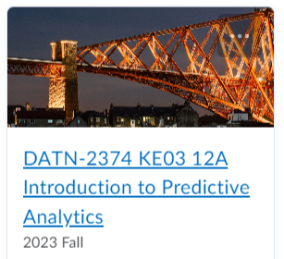
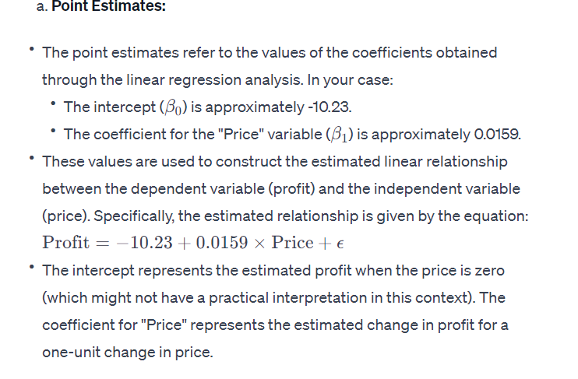
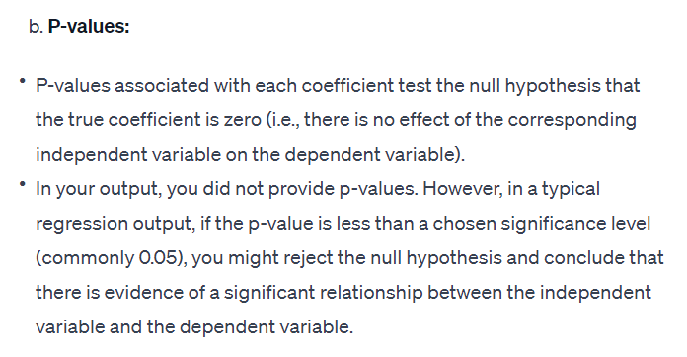
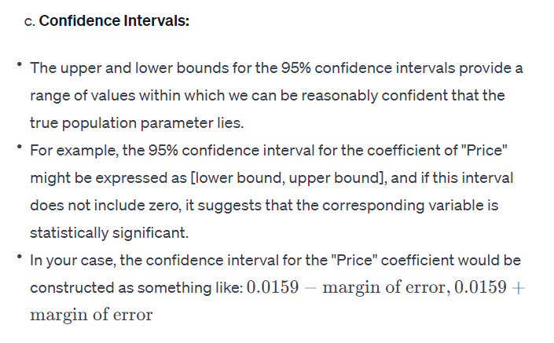
4. Fater applying your estimation method, explain: What do the point estimates mean? What do the p-values mean? What do the upper and lower bound for the 95% confidence intervals mean?

Slide 8
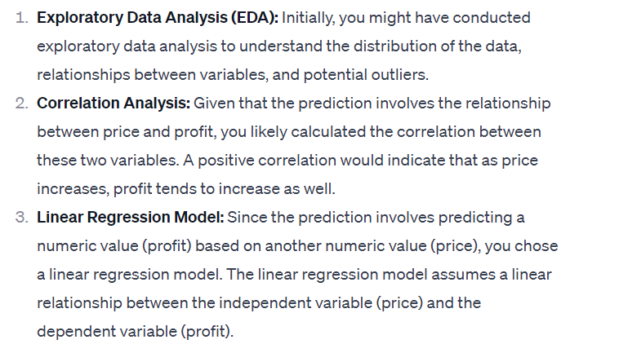
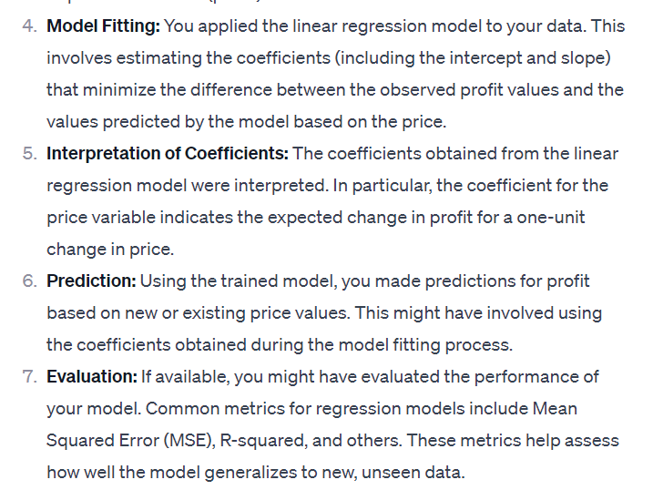
5. Detail the line of reasoning necessary to make your prediction in Question 1.
The reasoning behind the prediction involves understanding the relationship between price and profit in your specific dataset and leveraging this understanding to make predictions for new or unseen data points. Keep in mind that the quality of the prediction depends on the assumptions made during the modeling process and the representativeness of the dataset.

Slide 9
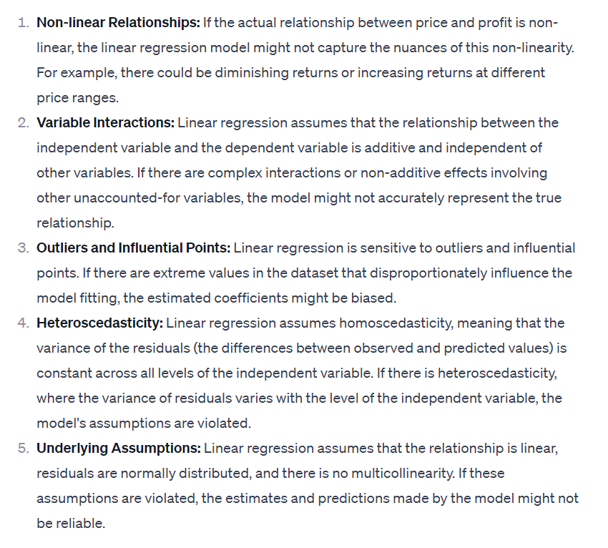
6. Identify at least one argument why your estimates may not be suitable for making the active prediction you made in question 1. Be sure to highlight where your line of reason breaks down if this opposing argument is correct.
In summary, if the relationship between price and profit deviates significantly from linearity, or if there are other complex patterns and interactions not accounted for by the linear regression model, the estimates may not be suitable for making accurate predictions. It's essential to consider alternative modeling approaches or conduct further analysis to address these potential limitations.

Slide 10


Thank You
Poly Bui
NGOCBBUI@MY.LONESTAR.EDU

